Slide 1
Using Streamlit to deploy web apps and machine learning models
by Leah Levy
linkedin.com/in/leah-levy-95338534
github.com/LLevy1/

Slide 2
Introduction
Python library
Open source
Owned by Snowflake
Lightweight
Strong community

Slide 3
Features
Minimal code
Customise with components
Live updates
Integration with Python libraries

Slide 4
Deploying ML Models
Deploying can be awkward
Need a quick solution
Basic flow:
Load a pre-trained model (e.g. using `pickle` or Hugging Face/TensorFlow)
Collect input from the user (e.g. using sliders or text inputs).
Make a prediction using the model and display the result.

Slide 5
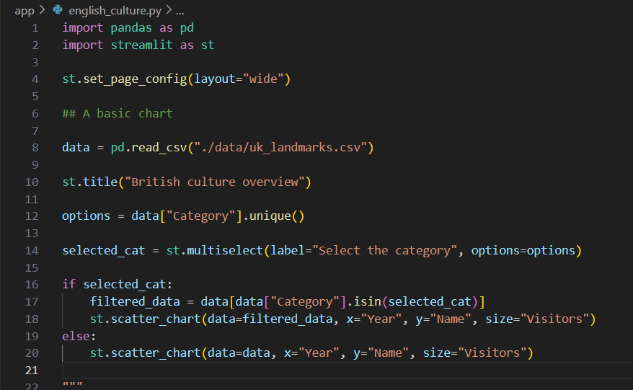
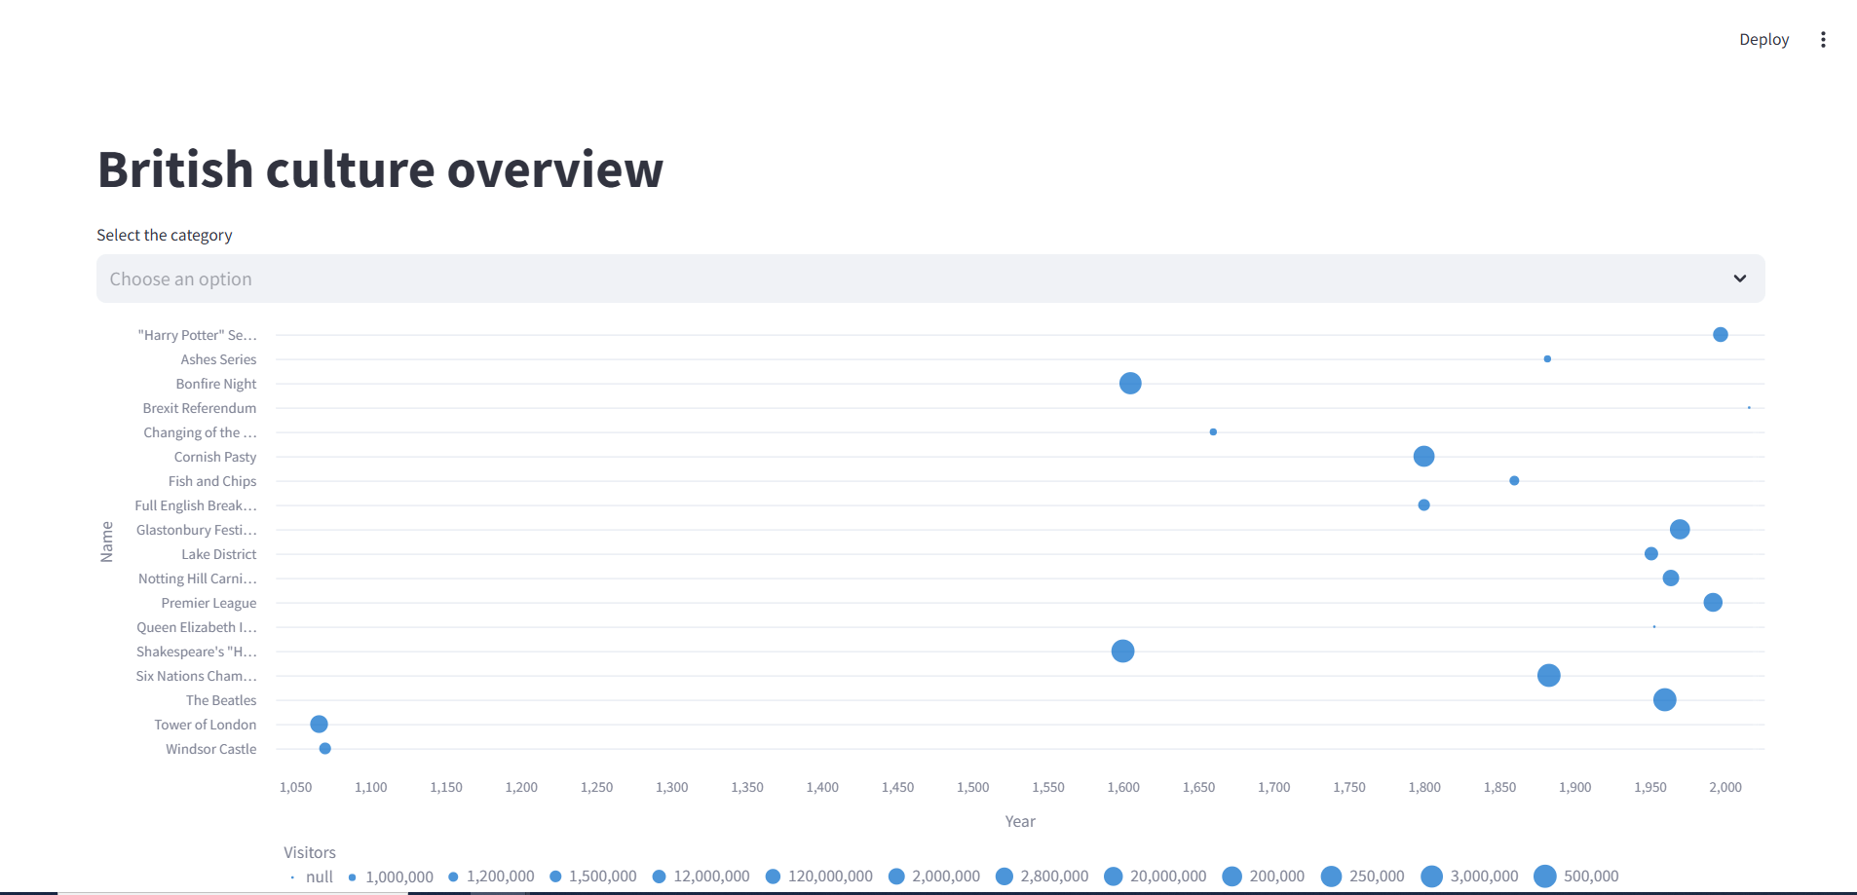
Basic app demo
Notes:
Pip install
Streamlit run my_app.py

Slide 6
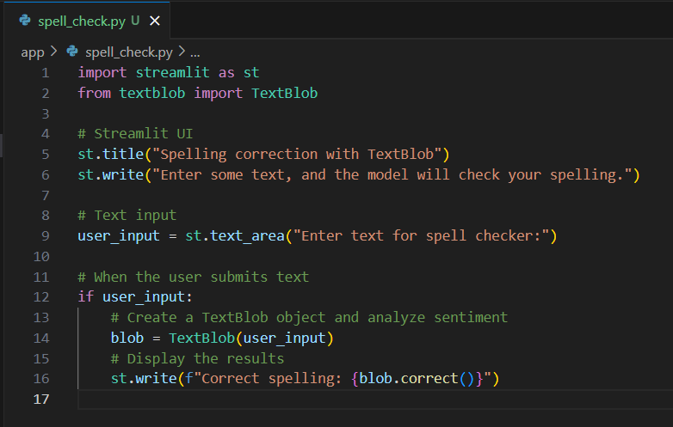
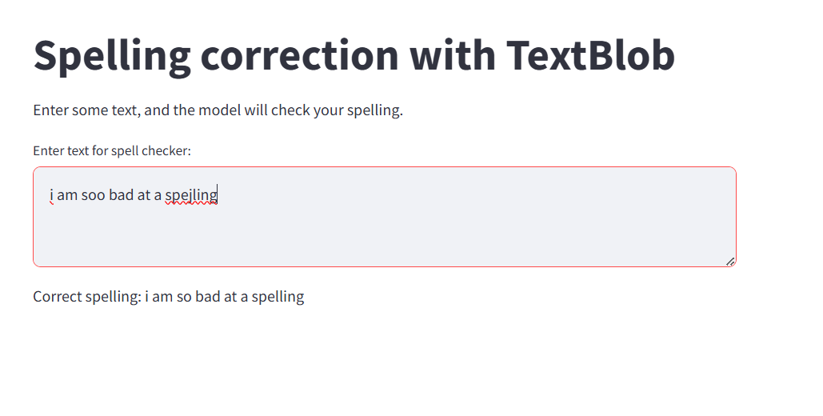
Demo

Slide 7
Deployment
Locally -> streamlit run my_app.py
Cloud
Streamlit Community Cloud
Docker
Kubernetes
AWS EC2, Heroku, Azure
Community cloud also provides analytics data
Notes:
Locally
Streamlit cloud directly deploy from GitHub
AWS/Google Cloud - if you need more flexibility and control over the infrastructure.
Analytics such as total viewers, most recent viewers, timestamp of viewers last visit etc.

Slide 8
Additional features & Security
Widgets, Status elements, extra pages
Integration for interactive maps and charts
App testing framework to simulate a running Streamlit app
Cache for large datasets
Integrattion for chat input for LLMs
Streamlit cannot see and do not store information contained inside Streamlit apps, such as text, charts, images, etc.
Don’t expose sensitive data
Ensure your app is protected from malicious input

Slide 9
Further reading:
Main site: https://streamlit.io/
Gallery: https://streamlit.io/gallery
Docs: https://docs.streamlit.io/
Thank you!
Any questions?
linkedin.com/in/leah-levy-95338534
github.com/LLevy1/

