Slide 1


Navigating Python's Dependency System
From Overload to Optimization
WHY UNDERSTANDING DEPENDENCIES MATTERS MORE THAN EVER
IN THE AI CODE GENERATION ERA
Python Community Meetup
Notes:
Welcome everyone
Set up the scenario: "Today we're going to look at a problem that's becoming more common, not less"
Introduce the AI angle: "Especially as we increasingly use AI tools to generate code"
Promise value: "By the end, you'll know exactly what to look for when reviewing code - whether written by humans or AI"
Time: ~1 minute

Slide 2

Intro
duction
Michael balber
Michael.balber@cyberark.com
Technion M.S.c
IAF Ofek 324
CyberArk (Palo Alto)
Principal software architect
Innovation labs, 4 years
AI and Data Office, 2 years
Python Community Meetup
Notes:
תוספת נוי

Slide 3
The Problem:
A production Python application takes 30 seconds to start
What we ruled out:
✓ Network latency
✓ Database connections
✓ CPU/memory issues
✓ Broken code
Python Community Meetup
Notes:
Present as a real scenario you've encountered (or heard about)
Walk through the elimination process naturally
Build intrigue: "Everything seemed fine, but something was clearly wrong"
Introduce the connection: "And we started noticing this more often in projects using AI assistance"
Time: ~1.5 minutes

Slide 4

Why This Matters Now?
The Reality:
AI tools are part of our daily workflow
What AI Does Well:
✅ Generates functionally correct code
✅ Follows syntax conventions
✅ Implements algorithms accurately
What AI Misses:
Performance optimization patterns
Dependency cost awareness
Project-specific architectural decisions
Our Responsibility:
Deep understanding of how python works to effectively review and optimize AI-generated code
Python Community Meetup
Notes:
Establish context: we all use these tools
Be balanced: "AI is incredibly useful and we're not here to criticize it"
The key point: "AI learns from existing code - including code with suboptimal patterns"
Personal example if you have one: "Last week, an AI tool gave me code that worked perfectly but would have added 10 unnecessary dependencies"
Frame the mission: "We need to understand these patterns deeply so we can review intelligently"
Time: ~2 minutes

Slide 5
Where's the Time Going?
Profiling the startup:
python -X importtime -c "import myapp" 2> profile.txt
What the data showed:
80% of the startup time spent in imports
Heavy libraries loaded at module level
The pattern in AI-generated code:
Static imports at the top of every file - the safe, conventional approach
Question: When is this approach suboptimal?
Python Community Meetup
Notes:
Introduce the profiling tool - this is practical and actionable
Show what you discovered through measurement
Make the AI connection naturally: "When you ask AI to write a function using pandas, it reliably adds 'import pandas' at the top"
Raise the question: "That's not wrong per se, but we need to understand when it's inefficient"
Transition: "To understand this, let's look at Python's three import mechanisms"
Time: ~2 minutes

Slide 6
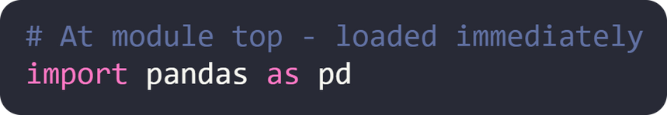
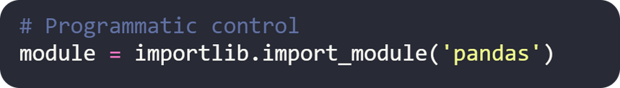
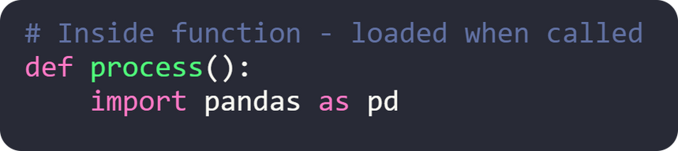
Understanding
Basic Import
Options
STATIC IMPORTS
DYNAMIC IMPORTS
LOCAL IMPORTS
Python Community Meetup
Notes:
Present these neutrally as the three options Python provides
Ask audience: "Which pattern do AI tools typically use?" (Static, almost always)
Set up the discussion: "Each has its place. The question is knowing which to use when"
Preview: "And more importantly, recognizing when AI has chosen suboptimally"
Time: ~1 minute

Slide 7
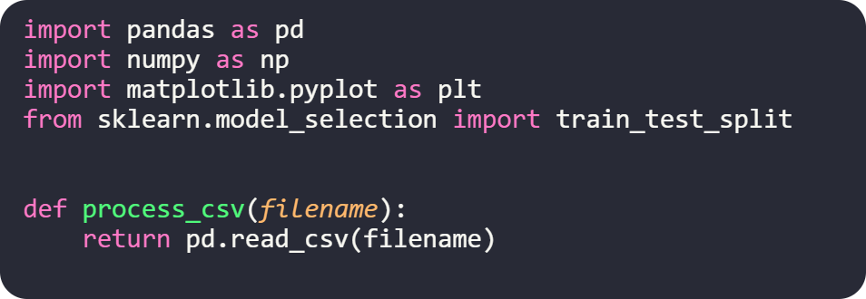
Static Imports: When AI Plays It Safe
Typical AI-generated code:
Analysis:
✅ Clear and explicit dependencies
✅ Functionally correct
❌ ALL modules loaded regardless of code path
❌ Slow import time for rarely-used functionality
Review question: Are these imports always needed?
Python Community Meetup
Notes:
Show how AI typically structures this
Emphasize: "This code works perfectly. It's not a bug. But there's a cost"
Real example: "AI added scikit-learn to my entire project for one optional feature"
The key insight: "AI doesn't distinguish between lightweight and heavy libraries"
What to look for: "When reviewing, ask yourself - is this function always executed?"
Time: ~2 minutes

Slide 8
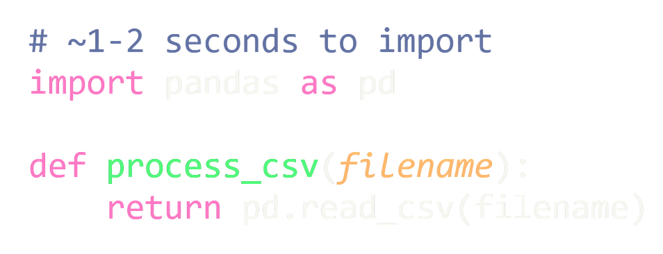
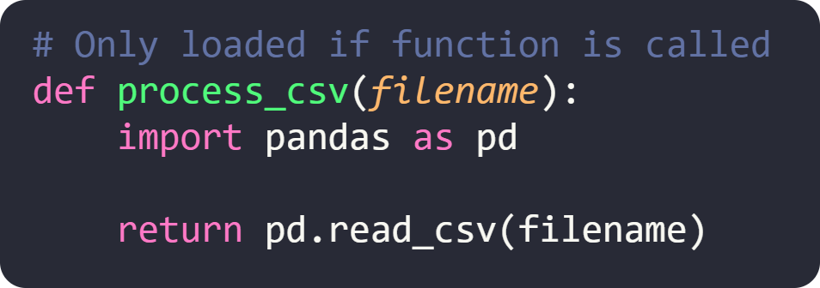
Optimizing with Local Imports
Before (AI-generated):
After (optimized):
Measured Impact:
Possible 50-80% reduction in startup time for conditionally-used modules
⚠️ Important: Small performance cost if called in tight loops - measure before optimizing
Python Community Meetup
Notes:
Show the straightforward transformation
Emphasize the significant impact with real numbers
Share results: "In one project, moving 5 imports to local scope reduced startup from 8s to 2s"
Address the concern: "Python caches imports, but there's still a small lookup cost. For functions in tight loops, this might matter - measure first"
The expertise gap: "You need to know which libraries are heavy. AI doesn't make this distinction consistently"
Quick mental checklist to share: "Is this library heavy? Is this function always called? Is it in a tight loop?"
Time: ~2 minutes

Slide 9
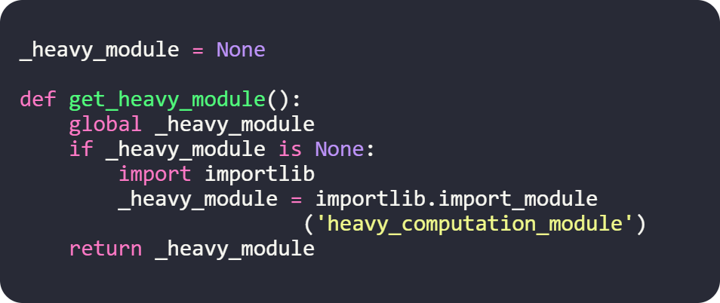
Dynamic Imports for Conditional Features
Pattern for optional functionality:
When to use:
Plugin architectures
Optional premium features
Environment-specific dependencies
Configuration-driven module loading
Note: AI rarely suggests this pattern - requires architectural thinking
Python Community Meetup
Notes:
Present this as the advanced option
Be clear: "Most codebases won't need this, but it's valuable to know"
Explain when it's appropriate: "When you have truly optional functionality or plugins"
The AI gap: "This requires architectural foresight that AI tools typically don't provide"
Example: "Loading different database drivers based on environment configuration"
Time: ~1.5 minutes

Slide 10
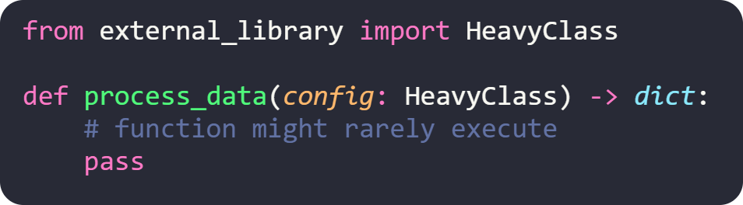
A New Challenge: Type Hints and Dependencies
AI generates well-typed code:
Unintended consequences:
Heavy library imported just for type annotation
Potential circular import errors
The tension: We want type hints (better code quality) without the import overhead
Python Community Meetup
Notes:
Transition naturally: "We've optimized our runtime imports, but there's another consideration"
Explain: "AI is trained to generate well-typed code, which is good"
But: "It doesn't consider the cost of imports used only in type hints"
Real scenario: "I asked ChatGPT to add type hints to a module, and it imported 3 new libraries that were only used in annotations"
Set up next section: "Python has features to address this, but you need to know they exist"
Time: ~1.5 minutes

Slide 11
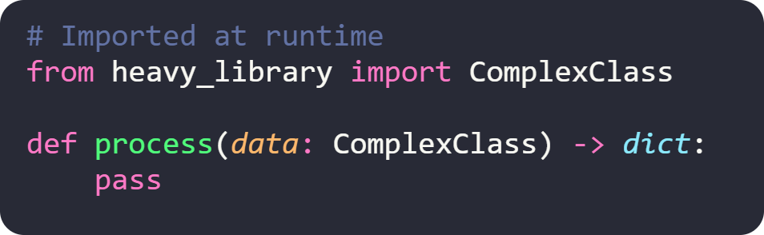
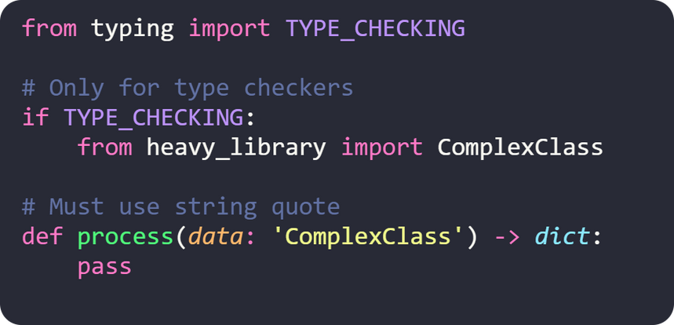
Separating Type-Time from Runtime
Default approach:
Optimized approach:
Result: Type checkers and IDEs see the type, but zero runtime import cost
Key: The string quote 'ComplexClass' is required when importing under TYPE_CHECKING
Python Community Meetup
Notes:
Introduce this as a powerful but underused Python feature
Explain the mechanism: "TYPE_CHECKING is False at runtime, True for static analysis tools"
The benefit: "Full type checking support without any runtime overhead"
Important detail: "You must use string quotes for types imported under TYPE_CHECKING"
When reviewing: "If an import is only used in type annotations, this is your optimization"
Common AI pattern: "AI will import the actual class even when only the type is needed"
Practical tip: "I now look for this pattern in every AI-generated file with type hints"
Time: ~2 minutes

Slide 12
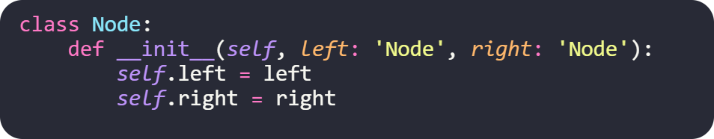
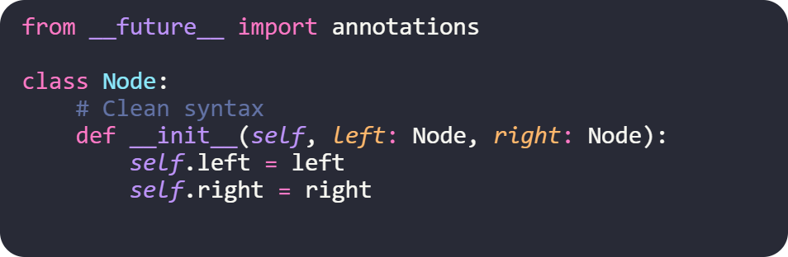
Future Annotations: Deferred Evaluation
Before Python 3.7 (string quotes required):
How it works:
All annotations become strings automatically - evaluated only by type checkers
With future annotations (Python 3.7+):
Note: This becomes default behavior in Python 3.11+
Python Community Meetup
Notes:
Show how this simplifies the code
Explain the history: "Before Python 3.7, you needed string quotes for forward references"
Available since 3.7: "You can opt-in with this future import"
Path forward: "This behavior is becoming the default in Python 3.10 and beyond"
The pattern to spot: "If you see many string-quoted type hints, add this import at the top"
Additional benefit: "Also helps resolve circular import issues between modules"
Quick recommendation: "Consider adding this by default to new modules - it's become a best practice"
Time: ~1.5 minutes

Slide 13
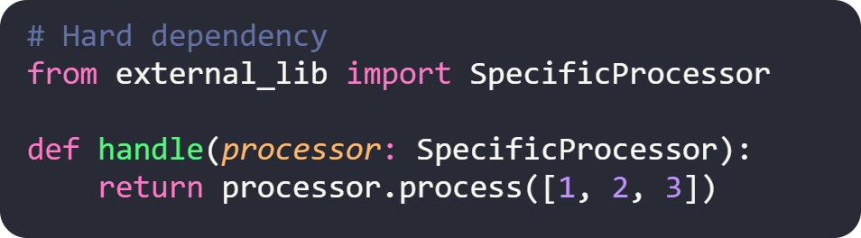
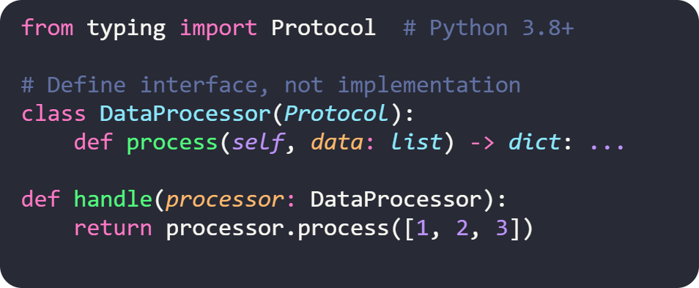
Protocol Types: Structural Typing
(Python 3.8+)
AI creates tight coupling:
You can design for flexibility
Any class with a matching signature works - no inheritance or imports needed
Requires: Python 3.8 or higher
Python Community Meetup
Notes:
Present this as the most sophisticated technique
Version requirement: "This requires Python 3.8 or higher"
Explain the concept: "This is structural typing - if it has the right methods, it satisfies the protocol"
The AI pattern: "AI tends to import specific classes; you can often replace with protocol definitions"
The benefit: "No dependency on specific implementations"
When to consider: "Defining interfaces, plugin systems, or library code where you want flexibility"
Time: ~2 minutes

Slide 14
Reviewing AI-Generated Code for Dependencies
Four-point checklist:
1. Heavy imports at module level → Consider local scope
2. Imports used only in type hints → Use TYPE_CHECKING block
3. Circular dependency → Add from __future__ import annotations
4. Tight coupling to specific classes → Consider Protocol types
The professional edge: Understanding these patterns transforms AI-generated code from "working" to "optimized"
Python Community Meetup
Notes:
Present this as their practical takeaway
Emphasize: "This is where your expertise adds value"
Frame the workflow: "AI writes the first draft, you refactor for production quality"
Walk through each point briefly:
Point 1: "Heavy libraries like pandas, numpy, tensorflow - do they need to load immediately?"
Point 2: "If you only see the class name in type hints, wrap the import in TYPE_CHECKING"
Point 3: "Lots of string quotes in your types? Add the future import at the top"
Point 4: "Importing specific classes from external libs? Think about whether a Protocol would give you more flexibility"
Suggest integration: "Add this checklist to your code review process"
Share personal practice: "I now run through this checklist on every AI-generated file before committing"
Time: ~1.5 minutes

Slide 15
Measuring and Maintaining Quality
Profiling:
python -X importtime - Identify slow imports
pipdeptree - Visualize dependency relationships
Enforcement:
import-linter - Define and enforce import rules, integrate into CI
e.g. check that certain modules or packages are not imported by parts of your project
Production:
py-spy - Profile running applications
Python Community Meetup
Notes:
These are actionable tools they can use immediately
Walk through each category:
Profiling: "Use -X importtime on your main modules to see where time goes. Use pipdeptree to understand your dependency tree"
Enforcement: "This is the key to preventing backsliding. Set up rules like 'no pandas in the API layer' and enforce them in CI"
Production: "py-spy lets you profile apps that are already running, without restarting them"
Emphasize automation: "Build this into your workflow, not just one-time fixes"
Example: "Configure import-linter to prevent pandas imports in your API layer"
The value: "Catches issues from any source - AI, other developers, or future you"
Suggest starting point: "Pick one project and run python -X importtime this week"
Time: ~1.5 minutes

Slide 16
Moving Forward: Your Action Plan
The Core Insight:
AI generates functional code; professional developers ensure optimal code
Four areas of expertise to develop:
1. Understand dependency costs - Know which imports are expensive
2. Apply strategic patterns - Choose the right import mechanism
3. Measure impact - Use profiling tools to validate improvements
4. Automate quality - Build checks into your development process
Python Community Meetup
Notes:
Bring everything together
Frame positively: "This knowledge makes you more effective, not replaceable"
Emphasize the partnership: "AI + your expertise = production-quality code"
Walk through the four areas briefly:
"First, build your knowledge of which libraries are heavy"
"Second, know when to use static, local, or dynamic imports"
"Third, always measure before and after - trust the data"
"Fourth, automate your checks so they happen on every PR"
Highlight the results: "50-80% is not a typo - these optimizations make a real difference"
Be specific about action: "Don't try to fix everything at once - start with one module"
Share encouragement: "You'll be surprised how much you find"
The bigger picture: "As AI becomes more prevalent, deep understanding becomes more valuable, not less"
Time: ~2 minutes

